Slide 1
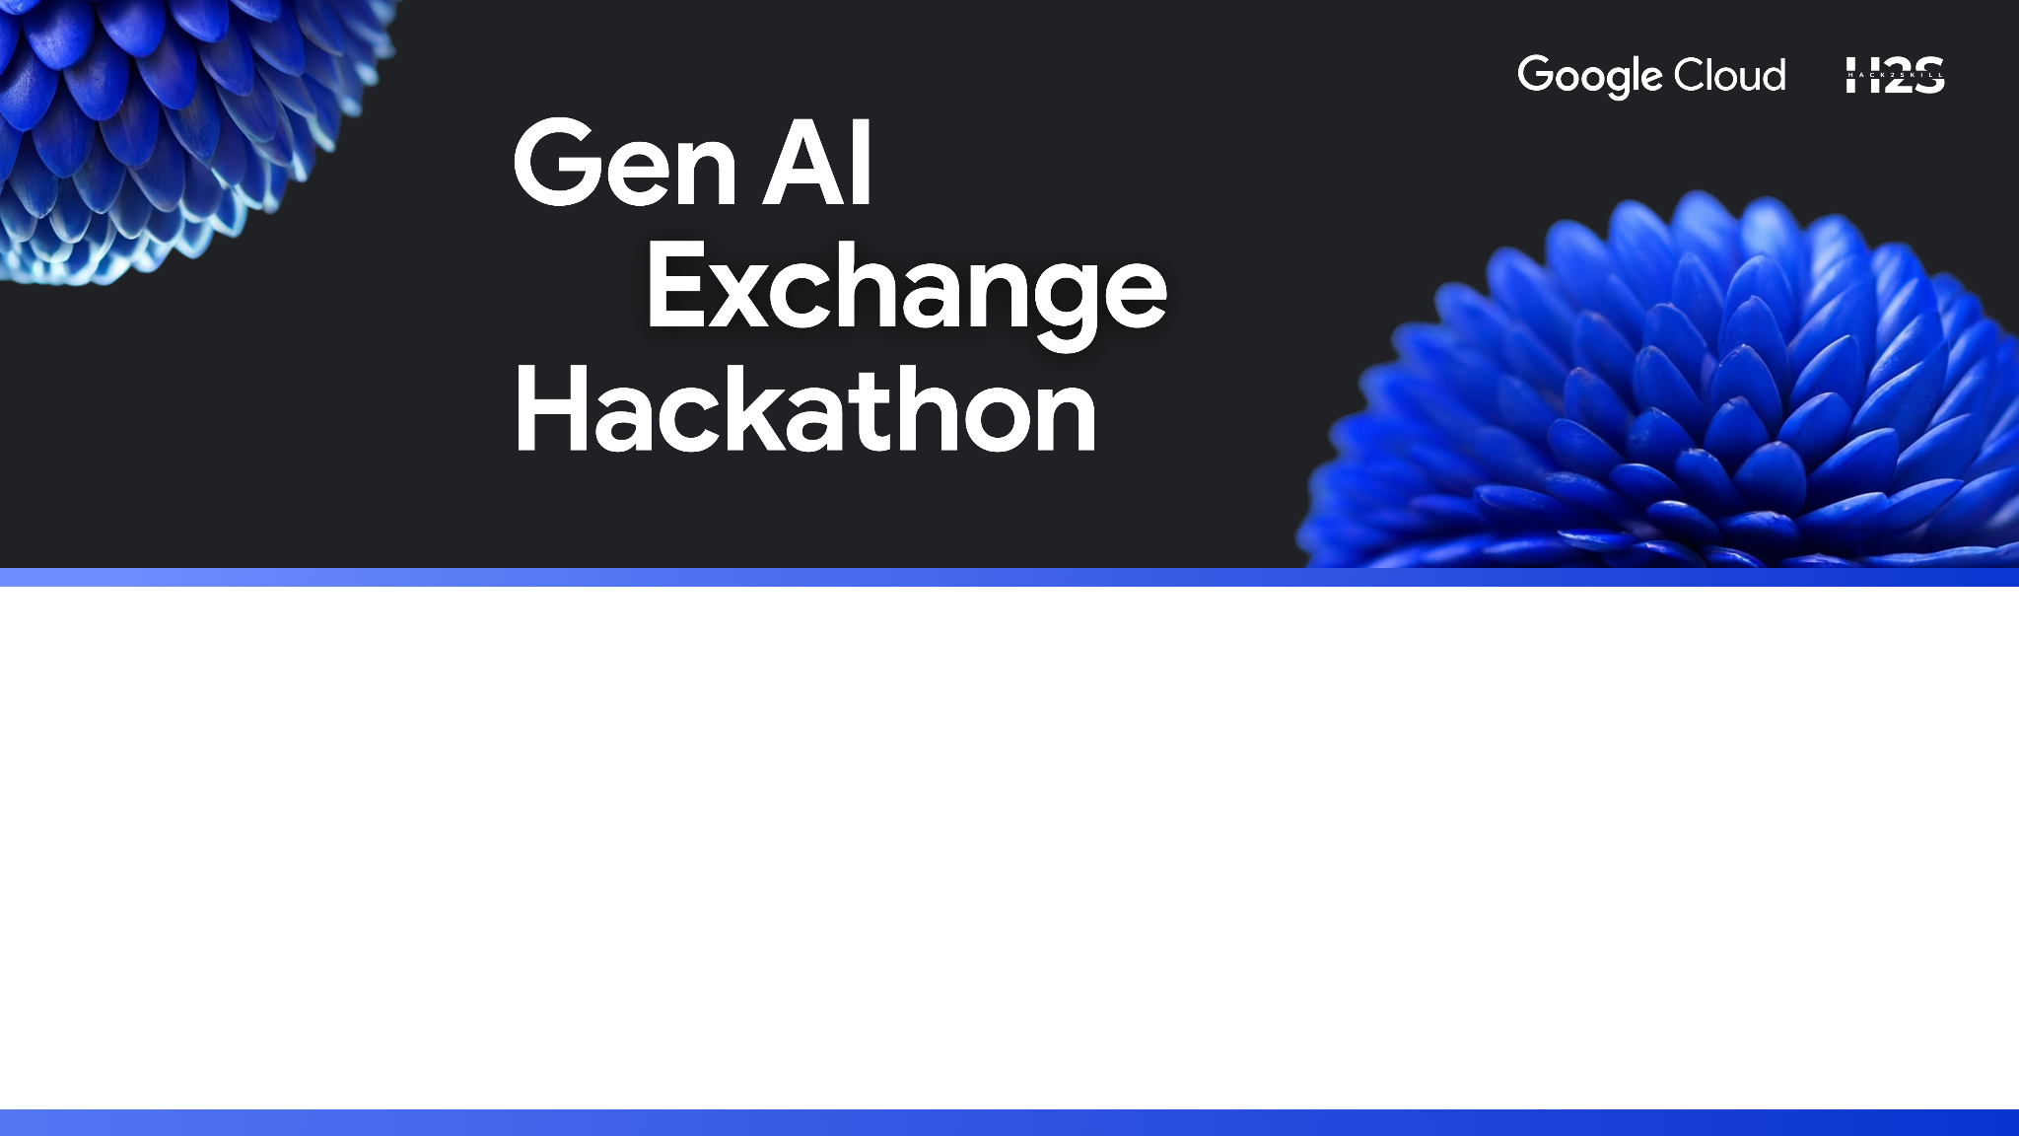
Team Name : GenAI_Adventurer
Team Leader Name : Yasmeen Begum
Problem Statement : Personalized Career and Skills Advisor

Slide 2
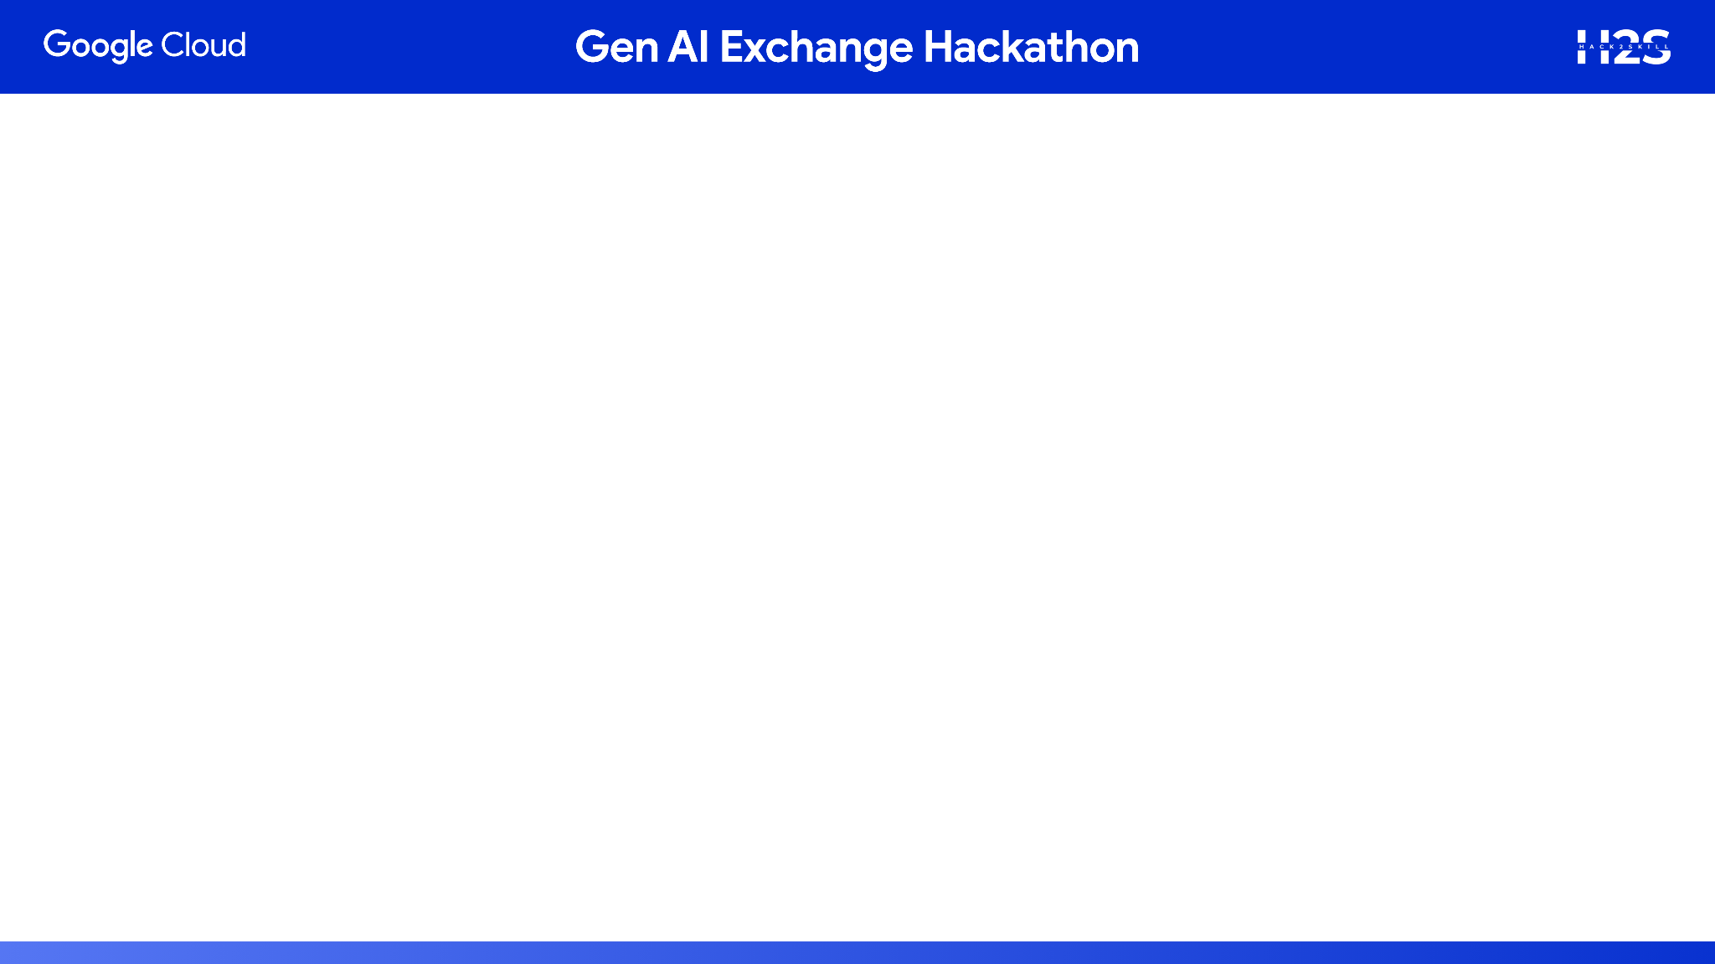
Brief about the prototype:
Layer | Component | Purpose
Frontend | Web App (Cloud Run) | Student interface for profile input, career exploration, and skill recommendations
Orchestrator Agent | Vertex AI Agent Engine | Coordinates multi-agent workflows, manages session state, and delegates tasks
Specialized Agents | Planner, Profiler, Recommender (Cloud Run + ADK + A2A) | Handle skill mapping, career path planning, and personalized recommendations
LLM Backbone | Gemini 2.0 Flash (Vertex AI) | Powers reasoning, instruction following, and tool use across agents
Database | Spanner (Graph Mode) | Stores user profiles, career paths, skill graphs, and agent interactions
Tool Server | MCP Server (Cloud Run) | Exposes APIs for external data sources (job market, certifications, etc.
DevOps | Cloud Build + Artifact Registry | CI/CD for agent containers and web app
Storage | Cloud Storage | Stores build artifacts, logs, and optionally annotated reports
Debugging | A2A Inspector | Live testing and inspection of agent interactions during development

Slide 3
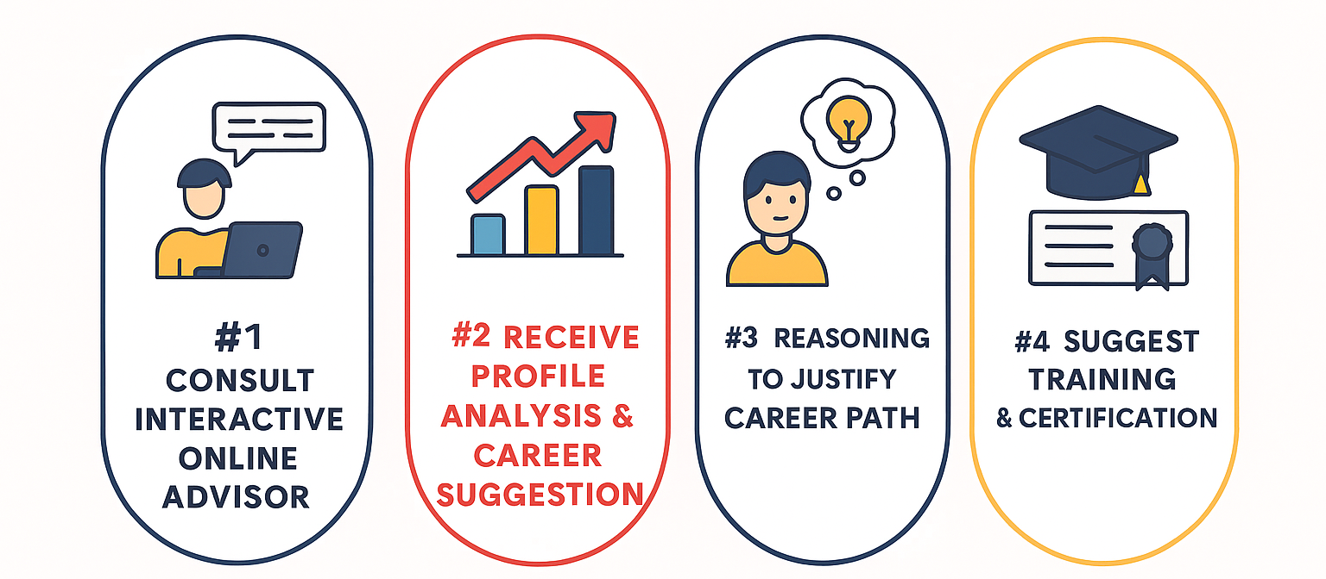
List of features offered by the solution

Slide 4
Opportunity should be able to explain the following:
How different is it from any of the other existing solutions?
Agentic Intelligence: Unlike static career portals or rule-based advisors, this system uses multi-agent orchestration powered by Gemini models to dynamically reason, adapt, and personalize guidance.
Graph-Based Profiling: It models student traits, skills, and career paths as a graph in Spanner, enabling nuanced recommendations based on relationships and trends.
Real-Time Adaptability: Through MCP integration, it pulls live data from job markets and learning platforms, ensuring advice stays relevant to evolving roles.
Tool-Using Agents: Agents don’t just suggest—they act. They query APIs, analyze gaps, and even recommend certifications with actionable links
How will it be able to solve the problem?
Personalization at Scale: Each student gets a unique roadmap based on their interests, aptitude, and goals
Skill Gap Bridging: The system identifies missing skills and suggests targeted learning paths, making students job-ready.
USP of the proposed solution
Modular, Scalable, and Cloud-Native: Built on GCP using Vertex AI, Cloud Run, and Spanner for seamless deployment and expansion.
Conversational & Actionable: Students interact naturally, and agents respond with reasoning.

Slide 5
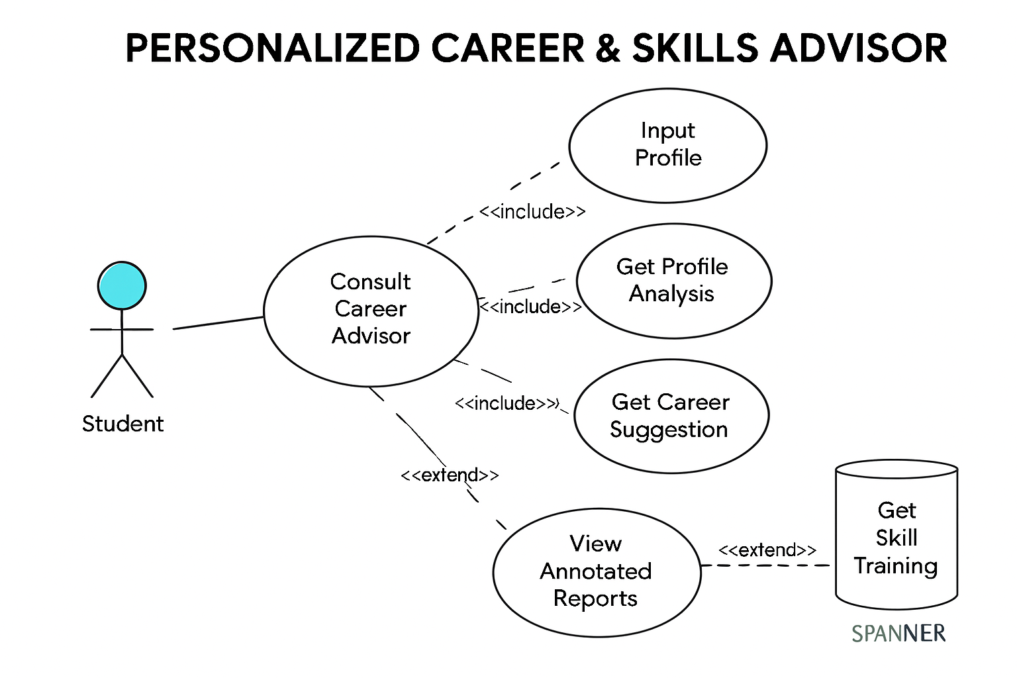
Process flow diagram or Use-case diagram
Add a flow diagram or a use case diagram or an architecture diagram.

Slide 6
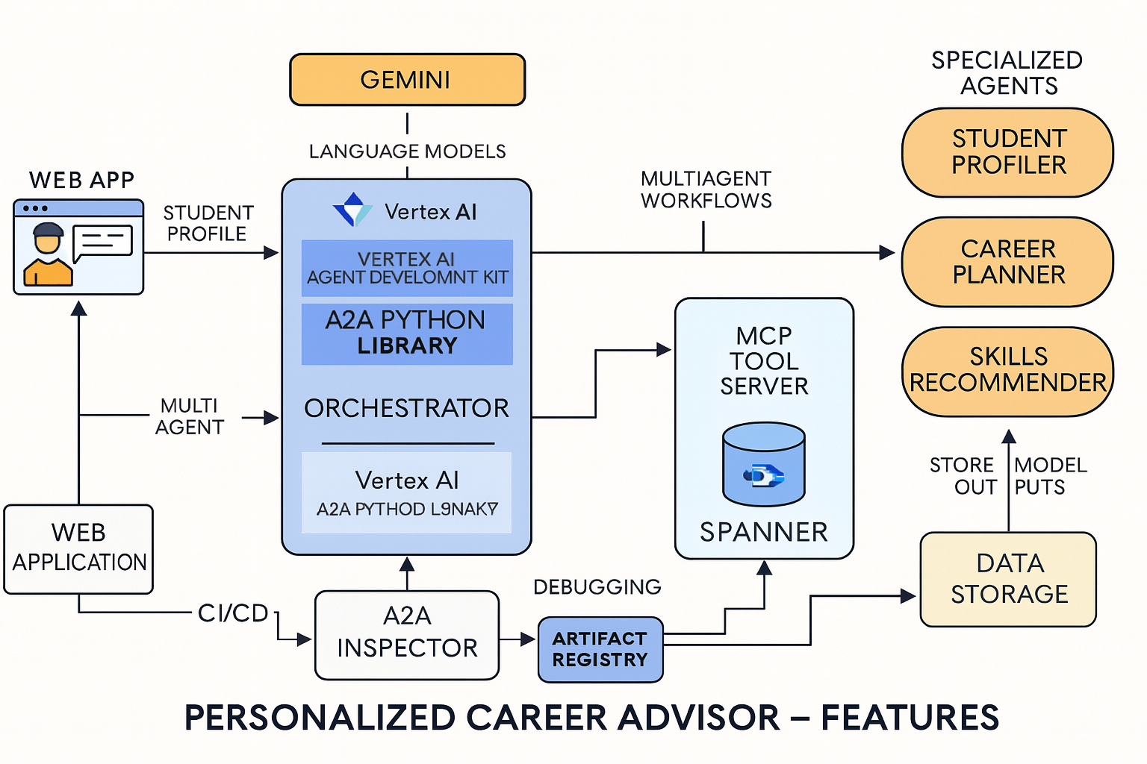
Architecture diagram of the proposed solution
A2A Python LIBRARY

Slide 7
Technologies to be used in the solution:
-AI & Agent Frameworks
Vertex AI (Gemini 2.0 Flash): For reasoning, instruction following, and tool use by agents
Agent Development Kit (ADK): To define agent logic, memory, and workflows
A2A Python Library: Enables agent-to-agent communication and task delegation
Model Context Protocol (MCP): Connects agents to external APIs and tools
- Backend & Microservices
Cloud Run: Hosts containerized agents (Profiler, Planner, Recommender) and the web app
MCP Tool Server: Exposes APIs for job market data, certification platforms, etc.
Spanner (Graph Mode): Stores student profiles, skill graphs, and career relationships
- DevOps & Infrastructure
Cloud Build: Automates Docker builds for agents and app
Artifact Registry: Stores and secures container images
Cloud Storage: For logs, annotated reports, and build artifacts
- Debugging & Testing
A2A Inspector: Live testing, agent card validation, and JSON-RPC inspection
-Frontend
React or Next.js (optional): For building the student-facing web interface
Material UI / Tailwind CSS: For clean, responsive design
-External Integrations
Job Market APIs (e.g., Lightcast, LinkedIn, Naukri)
Learning Platforms (e.g., Coursera, Google Career Certificates, SkillBoost)

Slide 8
Estimated implementation cost (optional):
Component | Service | Estimated Cost
LLM Inference | Vertex AI (Gemini 2.0 Flash) | ~$50–$150
Agent Hosting | Cloud Run (3–5 agents | ~$30–$100
Orchestrator Agent | Vertex AI Agent Engine | ~$50–$100
Database | Spanner (Graph Mode) | ~$100–$200
Tool Server | Cloud Run (MCP Server) | ~$20–$50
Storage | Cloud Storage | ~$10
CI/CD | Cloud Build + Artifact Registry | ~$10–$30
Debugging | A2A Inspector | Free (open-source tool)
Total Estimate: $270–$640

Slide 9
